Slide 1


PridePoint Bank
Risk Management at PridePoint
PD2
Yang YuQin 2002620

Slide 2
Table of Contents
Objective
Background
Points for discussion
Environment scan
Risk Assessment
Top 3 Risks
Mitigation Steps
Summary

Slide 3




Background
Mid-Sized Bank
A privately held regional bank
2,700 employees and 1,200 contract employees
Created from a merger
Between Prideful bank and OnPoint bank
Minors Bank
Formerly largest bank in region
62 branches
Total assets of $2.9 billion
Ten other smaller financial institution operating in the same area
Created through 2013 FDIC-assisted takeover by OnPoint Bank
Total assets of $3.3 billion
High percentage of non-performing loans

Slide 4


Role as a Director of Technology Infrastructure
Ensure daily operation
Reduce operational cost

Slide 5




Strategies
BUSINESS GOAL
Go public next year
Pursuing new consumer bank deposits
Stay Competitive
Improve branch-based consumer operations
Increase Profit

Slide 6



Environment scan/Area of concern

Slide 7







ENVIRONMENT SCAN
/AREA OF CONCERN:
Shortage of manpower
No early detection
Lack of IT security awareness
Half of the information security staff has been eliminated.
No monitoring or logging of internal traffic
Security awareness training has been cancelled.

Slide 8



ENVIRONMENT SCAN/AREA OF CONCERN:
Long data recovery
Dependent on third party
insecure protection
Full operating capacity should be available no more than 12 hours after activation of
the DRP
Third-party contractors are trained to complete the process without ​
assistance from the Prideful data centre​
Firewalls on client systems currently allow all traffic

Slide 9




Risk Assessment

Slide 10

The Delphi Technique
How data is collected?
A survey is issued to all sectors under
Information Technology
Information Security
Engineers

Slide 11









Risk Identified
PHISHING
INSIDER ATTACK
DISCLOSURE OF CLIENT DATA TO A COMPETITON
VIRUS INFECTION
THIRD-PARTY UNABLE TO PROVIDE SERVICES
HACKTIVISM
INAPPROPRIATE SEGREGATION OF NETWORKS
INAPPROPRIATE ACCESS RIGHTS

Slide 12
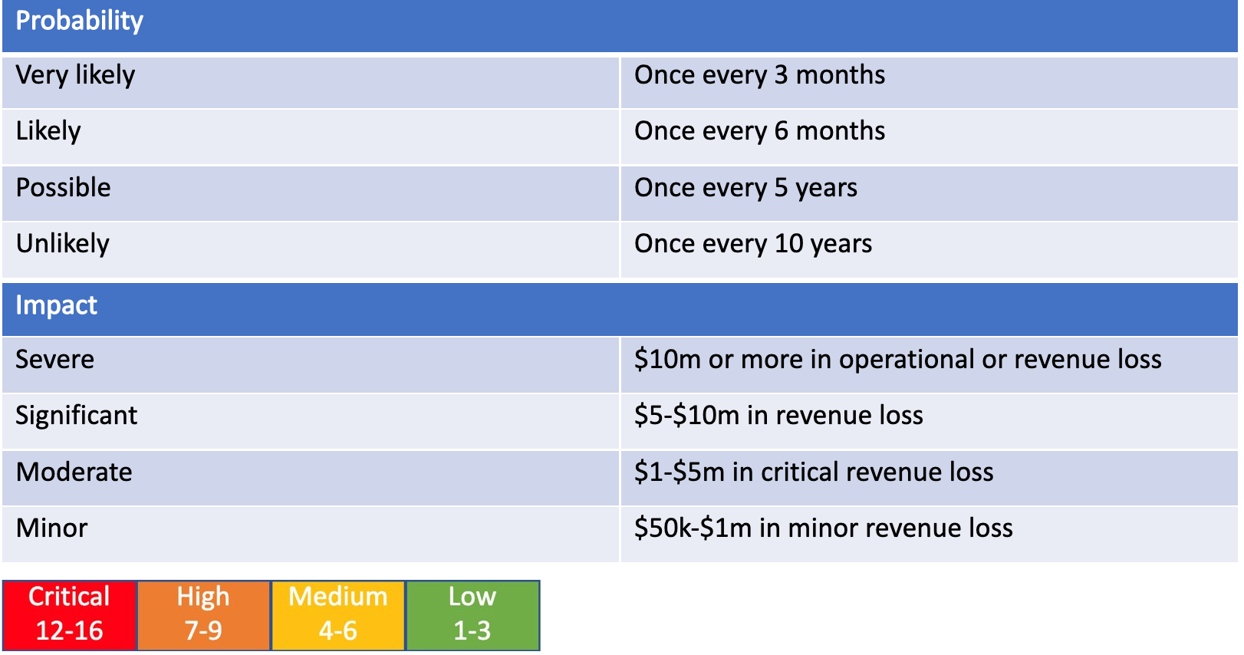
Risk define:

Slide 13
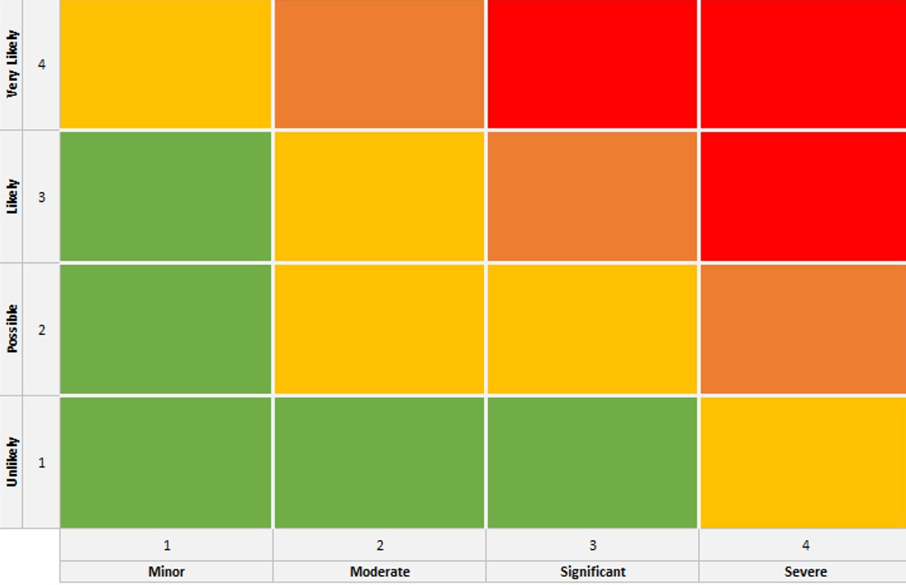
PHISHING
THIRD-PARTY UNABLE TO PROVIDE SERVICES
INSIDER ATTACK
VIRUS INFECTION
INAPPROPRIATE SEGREGATION OF NETWORKS
DISCLOSURE OF CLIENT DATA TO A COMPETITON
HACKTIVISM
INAPPROPRIATE ACCESS RIGHTS

Slide 14
3 Risks
PHISHING
THIRD-PARTY UNABLE TO PROVIDE SERVICES
VIRUS INFECTION

Slide 15

Second Risk
Third-party unable to provide services

Slide 16

RISK SCENARIO:THIRD-PARTY UNABLE TO PROVIDE SERVICES
Actor
Name: John
Job:third party data recovery staff
Situation:Loss of job
PART 2
12 / 19

Slide 17


RISK SCENARIO:THIRD-PARTY UNABLE TO PROVIDE SERVICES
ASSUME:
Overall economic of the nation is not doing well
Many companies are cutting down wages
Event
Third party company having financial issues/strike
Unable to pay employee's salary
Staff is unavailable to recover data for PridePoint
TO THE NEW YEAR

Slide 18




RISK SCENARIO:THIRD-PARTY UNABLE TO PROVIDE SERVICES
Threat
LOSS OF DATA
FINANCIAL LOSS
PROMPT TO DATA LEAK

Slide 19




RISK SCENARIO:THIRD-PARTY UNABLE TO PROVIDE SERVICES
Asset
Loss of business
Business operation will be affected
IT infrastructure unable to operate

Slide 20


RISK SCENARIO:THIRD-PARTY UNABLE TO PROVIDE SERVICES
Time
Able to detect system failure early
Need time to negotiate new third party service
Need longer time for other third party to be familiar with operation
longer time needed to repair

Slide 21





RISK MODEL:THIRD-PARTY UNABLE TO PROVIDE SERVICES
Probability​
Risk =Probability X Impact
3X3 = 9
Impact​
​
Impact: Significant
Probability: Likely
Risk Level: High risk

Slide 22

RISK RESPONSE:THIRD-PARTY UNABLE TO PROVIDE SERVICES
TRAIN
more staff and find lesser third party
SIGN
Escrow agreements
FIND
reliable third party

Slide 23
Third Risk
Virus Infection

Slide 24



RISK SCENARIO:VIRUS INFECTION
Actor
Name : Jack
Position: Pridepoint Central management staff
Situation: Did not undergo training, due to cost cut and shortage of staff, to learn about new virus
Name : Tom
Position: Hacker
Situation: Love to hack exploit vulnerability

Slide 25


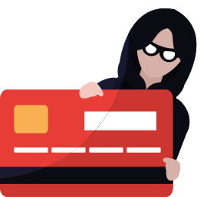
RISK SCENARIO:VIRUS INFECTION
event
2
3
1
Virus was installed on Pridepoint server.Server unable to access due to virus
Loss of sensitive information and data leak
No monitoring of log and internal server, did not suspect malicious act

Slide 26

RISK SCENARIO:VIRUS INFECTION
Threat
1
2
3
Server unable to access
Financial Loss
Loss of Trust

Slide 27


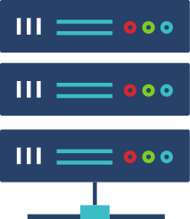

Page 4
RISK SCENARIO:VIRUS INFECTION
Asset
Business operation would be affected
IT infrastructure would be affected

Slide 28

RISK SCENARIO:VIRUS INFECTION
Time
The detection of the virus infection is fast
Recovery time is long as the attack of the enterprise’s IT infrastructure destroys information.

Slide 29
RISK MODEL:VIRUS INFECTION
Probability​
Risk =Probability X Impact
3X4 = 12
Impact​
​
Impact: Severe
Probability: likely
Risk Level: Critical

Slide 30

RISK RESPONSE:VIRUS INFECTION
TRAIN
more staff
MONITOR
logs and suspicious activities
UPDATE
software and hardware regularly

Slide 31
First Risk
Phishing

Slide 32




RISK SCENARIO:PHISHING
Actor
Name: Mary
Job: Administrator
background: Not trained on IT security precaution
Name:John
Job:Scammer
Background: Skilled in phishing

Slide 33



RISK SCENARIO:PHISHING
event
3
1
2
Hacker was able to get sensitive information of Pridepoint
Pridepoint staff clicked on a phishing link in staff email unknowingly due to lack of training
Malware was installed on Pridepoint computer

Slide 34



RISK SCENARIO:PHISHING
Threat
CUSTOMER'S SENSITIVE INFORMATION MAY BE LEAKED
HACKER MAY USE INFORMATION TO GAIN ACCESS TO PRIDEPOINT
HACKER MAY THREATEN PRIDEPOINT FOR MONEY

Slide 35



RISK SCENARIO:PHISHING
Asset
Business cannot operate normally
Sensitive information stolen
Loss of customers
Financial loss

Slide 36

RISK SCENARIO:PHISHING
TIME
Need longer time to detect
Need longer time to recover loss data

Slide 37
RISK MODEL :PHISHING
Probability​
Risk =Probability X Impact
4X4 = 16
Impact​
​
Impact: Severe
Probability: very Likely
Risk Level: Critical

Slide 38

RISK RESPONSE:PHISHING
TRAIN
staff to be more vigilant
UPGRADE
email service, which includes a spam filtering service
MONITOR
using intrusion detection systems (IDSs)

Slide 39
Conclusion
PHISHING
THIRD-PARTY UNABLE TO PROVIDE SERVICES
VIRUS INFECTION
Solution: Train staff
Solution:Reliable third party
Solution:Monitor system

Slide 40


THANK YOU

Slide 41
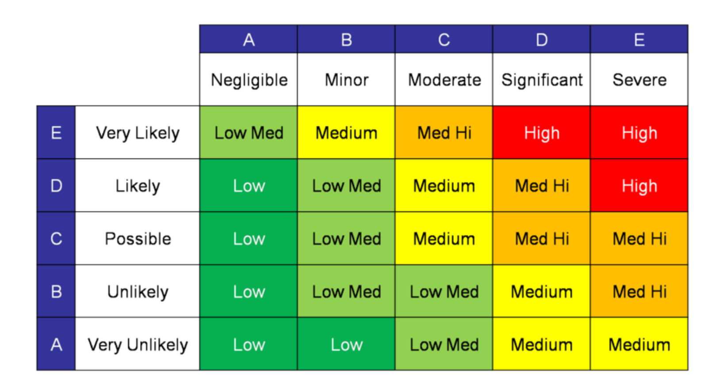

Risk Model
Risk Level: Significant
Probability: possible
Impact: Med High Severe

Slide 42

Risk Scenario
Threat
A malware is implemented in two data system
Time
Actors
Extended period of time required to upgrade or replace network infrastructure
Detection is moderate due to security events not detected immediately
Consequences is immediate because there is momentarily no business
Internal staff who holds managerial position
External developers who creates malicious malware
Summary
Assets
Event
Impact to Business Processes which cannot be operated due to ineffective patch management and security incident procedure
Interruption caused by systems not available
Ineffective design of the network architecture.
Damage IT infrastructure,

Slide 44

Third-party unable to provide services
Currrently:
Third party site is trained to complete data recovery process
without Prideful data centre
Possible scenario
Third party is understaff and is not able to provide service
Data recovery will be down

Slide 45
Risk Scenario
Threat
Third-party is unable to provide service
Unable to recover data timely
Actors
External third party labour
Time
Summary
Long recovery time
Event
Assets
Interruption of the IT services from the third party.
business processes that are not being performed,
IT infrastructure that is not recovered,

Slide 46
Risk Scenario
Threat
Failure to comply management rules and may escalate privileges.
Actors
Internal staff
Time
Summary
timing of the event is extended
Assets
Event
Business impact
ineffective design and/or ineffective execution
organizational structures

Slide 47











Thank You for Watching
Next
video
Next
video
Like & Subscribe

Slide 48
Risk Model
Risk Level: Significant
Probability: possible
Impact: Med High Severe

Slide 49



Risk Response
1)Risk Avoidance: Strict management rules
2)Risk Acceptance:Acceptance of the risk
3)Risk Sharing:N/A
4)Risk Mitigation:Frequent review and immediate removal of inappropriate access rights

Slide 50
RISK SCENARIO:THIRD-PARTY UNABLE TO PROVIDE SERVICES
Annualised Loss Expectancy =Annual Rate of Occurrence X Single Loss Expectancy
= 1/5 X 10M
= 2M
Risk Model

Slide 56
How people worked without tech
How people work with tech
Longer time is spent on individual tasks.
Communication was more complex and tedious.
Managing data was done manually and involved a ton of paperwork.
New tools enable work to be done much faster and easier.
Communicating with colleagues, no matter where they are in the world, is incredibly fast and convenient.
Everything is digital and easier to file, manipulate, or keep track of.

Slide 57



On Company Growth
How tech helps companies evolve and innovate
NEW AVENUES FOR PROGRESS
EASE OF MANAGEMENT
BETTER PLATFORMS FOR EMPLOYEES
Businesses are now able to improve the way they operate, from streamlining processes to handling consumer transactions.
Technology presents new ways to engage with consumers
and provide new services they may need in this age of advanced tech.
Employees have access to a vast array of tools to improve the way they work, no matter how complex a task.

Slide 58
EASIER WAYS OF WORKING
On Employee Happiness
Several platforms offer different tools and features employees can use to make each task more convenient and effective.
FASTER MEANS OF COMMUNICATION
Interacting with colleagues and sending out a message to anyone in and out of the country takes no time at all.
EFFECTIVE TIME MANAGEMENT
How tech makes accomplishing work easy and satisfying
Getting work done faster means employees can dedicate more time to life outside of work, especially for remote positions.

Slide 59
Is remote work here to stay?
How working from home might be the way to go
Now that it's become even more evident that finishing tasks and communicating with colleagues can all be quickly done even when every employee stays at home, plenty of companies see how remote work is the better path to take. It's cost-effective, easy, and safe, so it's no wonder why some businesses are starting to make remote work the norm.

Slide 60

While remote work has its perks, the ability to switch off after a day's work may be even more difficult as you find that the space you spend hours working in is the same space that used to only be for rest and relaxation.

Slide 61

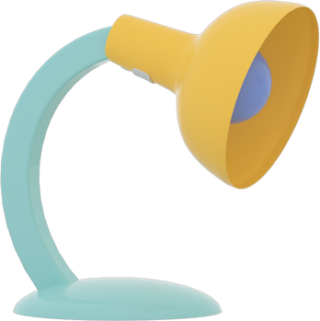


What's Next in Tech Workspace
Increased task automation and use of artificial intelligence.
Extra focus on high-value tasks.
Continuous investment in cybersecurity and security technology.
A better conscious focus on mental health.
Greater geographic distribution and representation of the workforce.

Slide 62
Science and technology revolutionize our lives, but memory, tradition and myth frame our response.
ARTHUR SCHLESINGER

Slide 63

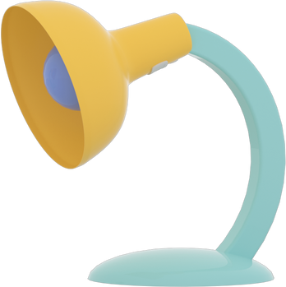
Do you have any questions?
Send it to us! We hope you learned something new.

Slide 64
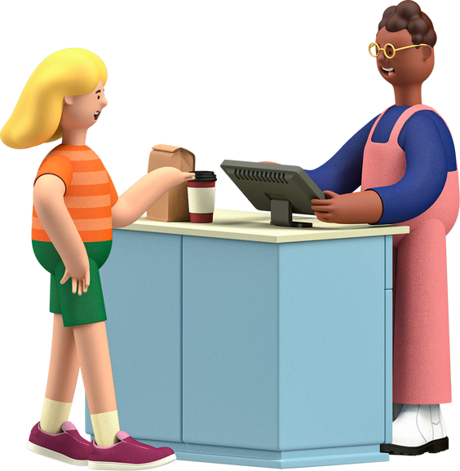



Free Resources
Use these free recolorable icons and illustrations in your Canva design

Slide 65


Free Resources
Use these free recolorable icons and illustrations in your Canva design

Slide 66













Free Resources
Use these free recolorable icons and illustrations in your Canva design

